Slide 1
Advanced Techniques with Large Language Models Lecture 4
Northeastern University
College of Engineering
Multidisciplinary Graduate Engineering Department
INFO 6105 – Fall 2024
Instructor: Abdolreza Mosaddegh

Slide 2
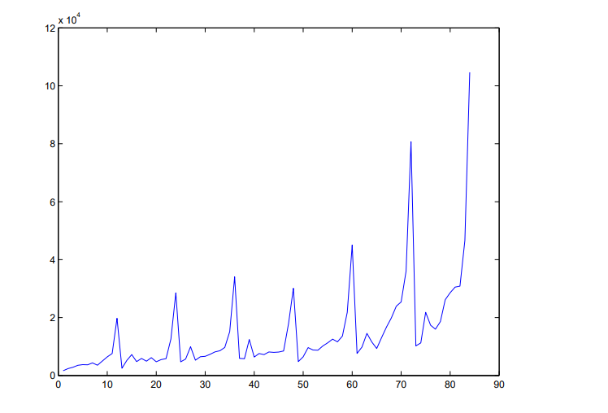
Time Series
A time series is a sequence of data points indexed in time order.
Most commonly, a time series is a sequence taken at successive equally spaced points in time. Thus, it is a sequence of discrete-time data.
Time series types:
Stationarity
Non-stationary
Monthly sales for a shop

Slide 3
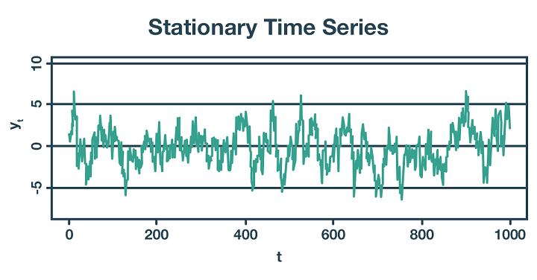
Stationarity Time Series
A stationary process has the property that the mean, variance and autocorrelation structure do not change over time, implying that the probability lies in a particular interval is the same now as at any point in the past or the future.
Prediction on this type of data can be done regardless of previous conditions (e.g., flipping a coin several times)

Slide 4
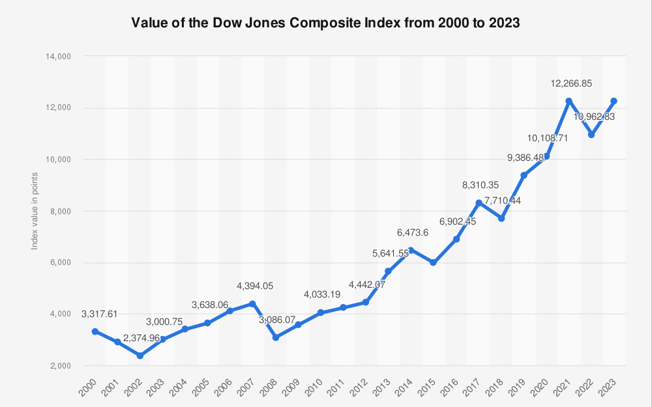
Non-stationary Time Series
A non-stationary time series is one whose statistical properties, such as the mean, variance, or autocorrelation, change over time.
Prediction on this type of data should consider a sequence of data over time (e.g., sequence of changes in a stock market).

Slide 5
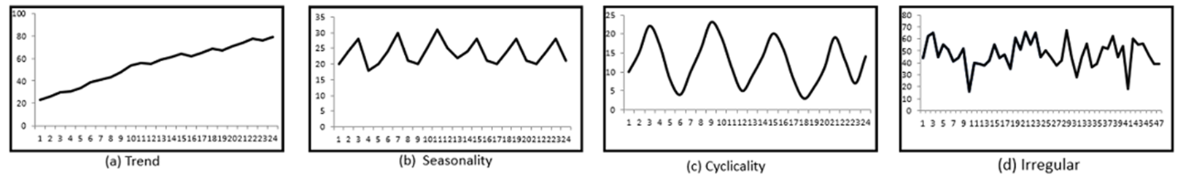
Components of Time Series
In general, any time series may be decomposed into four components:
Trend : increasing or decreasing long term pattern
Seasonal : regular fluctuations during the same time periods
Cyclical: rises and falls that occur over irregular, long-term intervals
Random: every time series has some unpredictable component (random variable).

Slide 6
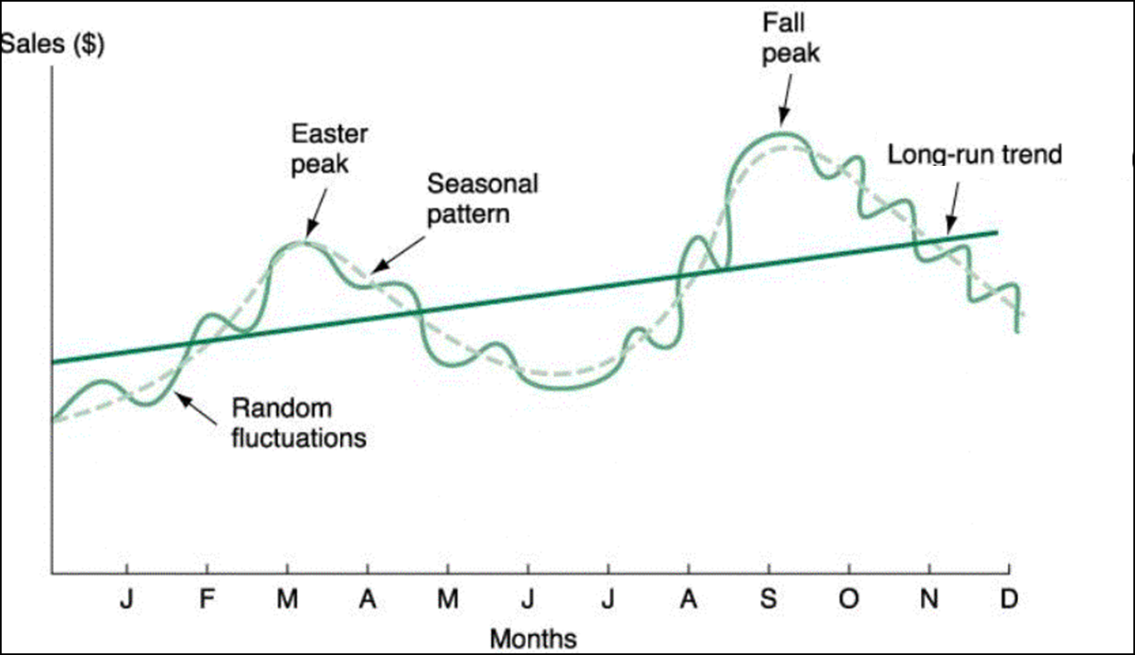
Prediction of Time Series
These components may be combined in different ways.
In prediction, the objective is to model all the components to the point that the only component that remains unexplained is the random component.
For prediction in time-series data using neural networks we need a type of NN which can predict based on a sequence of data over time

Slide 7
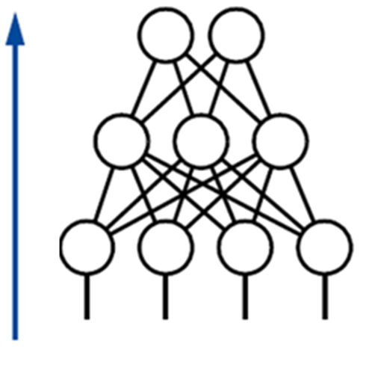
Limitations of Feed Forward Neural Networks
Time series data have an inherent temporal order (each data point is related to its previous data points)
A feedforward neural network treats all inputs independently and doesn't explicitly capture relationships between them across time
We need a structure that can model dependencies of inputs over time
This dependencies can be represented by a sequence of data
𝑦
𝑉
ℎ
𝑈
𝑥

Slide 8
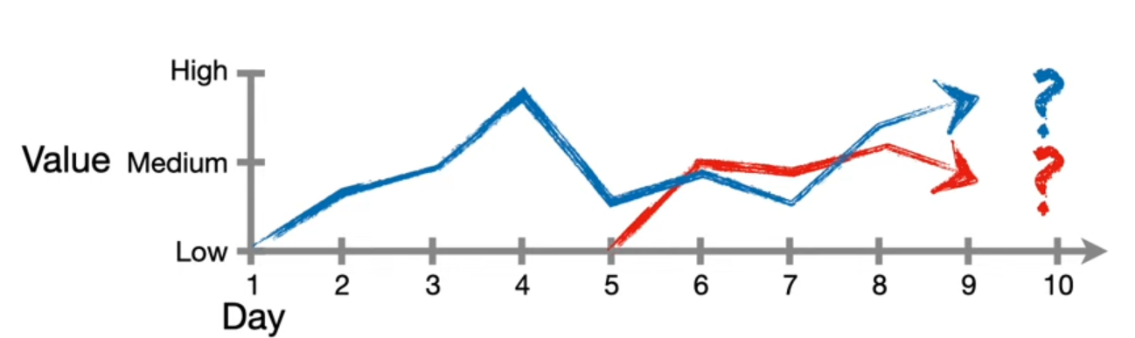
Requirements of Time Series in Neural Networks
In time series not just conditions in a point of time but a sequence of conditions are needed for prediction /classification
Length of sequential data required for a prediction can be different in different applications, datasets or even individual samples

Slide 9
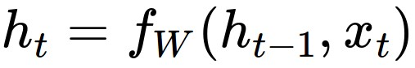
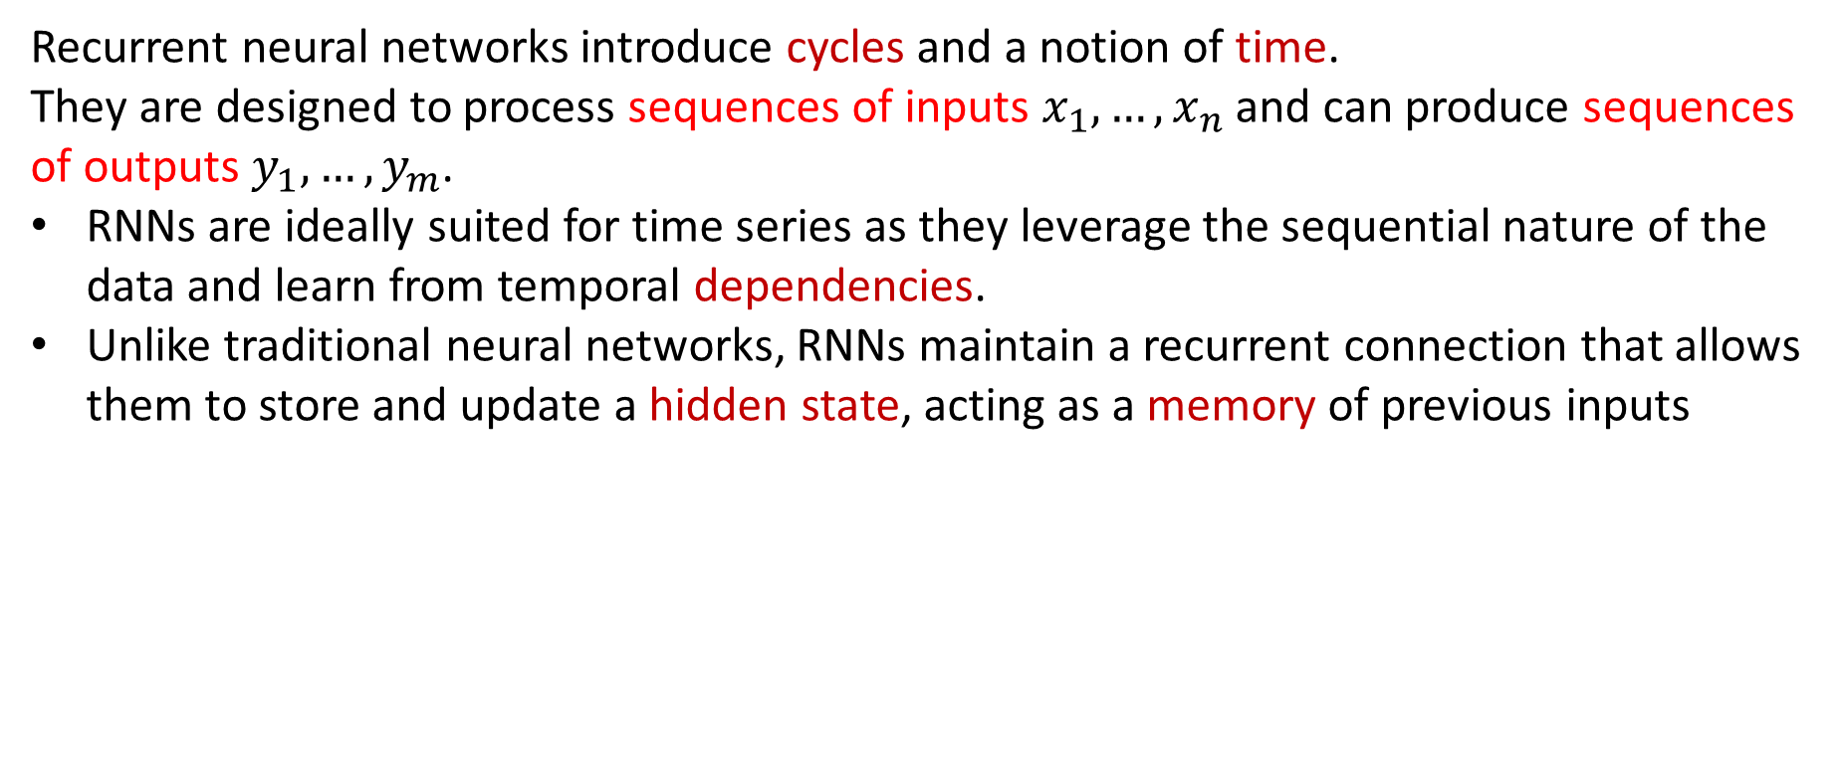
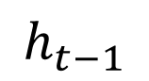
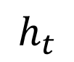
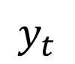
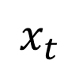
Recurrent Neural Network
Recurrent Neural Networks (RNNs)
Recurrent neural networks introduce cycles and a notion of time.
They are designed to process sequences of inputs $x_{1},…,x_{n}$ and can produce sequences of outputs $y_{1},…,y_{m}$.
RNNs are ideally suited for time series as they leverage the sequential nature of the data and learn from temporal dependencies.
Unlike traditional neural networks, RNNs maintain a recurrent connection that allows them to store and update a hidden state, acting as a memory of previous inputs
$$x_{t}$$
$$y_{t}$$
$$h_{t−1}$$
$$h_{t}$$
new state
old state
some function
with parameters
input vector at some time step
One-step delay

Slide 10

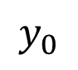
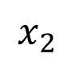
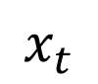
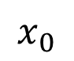
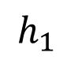
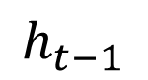
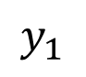
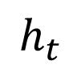
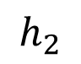
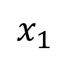
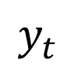
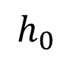
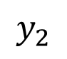
Recurrent Neural Network
Unrolling RNNs
RNNs can be unrolled across multiple time steps.
The size depends on the input sequence length.
Since these steps represent a same function over time the parameters of all step are the same
$$y_{0}$$
$$x_{0}$$
$$h_{0}$$
$$y_{1}$$
$$x_{t}$$
$$y_{t}$$
$$x_{1}$$
$$h_{1}$$
$$h_{t−1}$$
$$h_{t}$$
$$y_{2}$$
$$x_{2}$$
One-step delay
$$h_{2}$$
Parameters to be learned: U, V, W
Same parameters for all time points

Slide 11
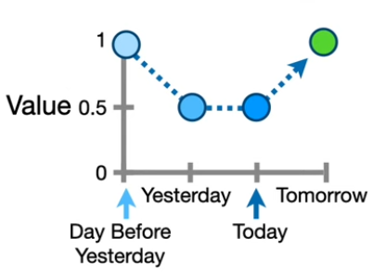
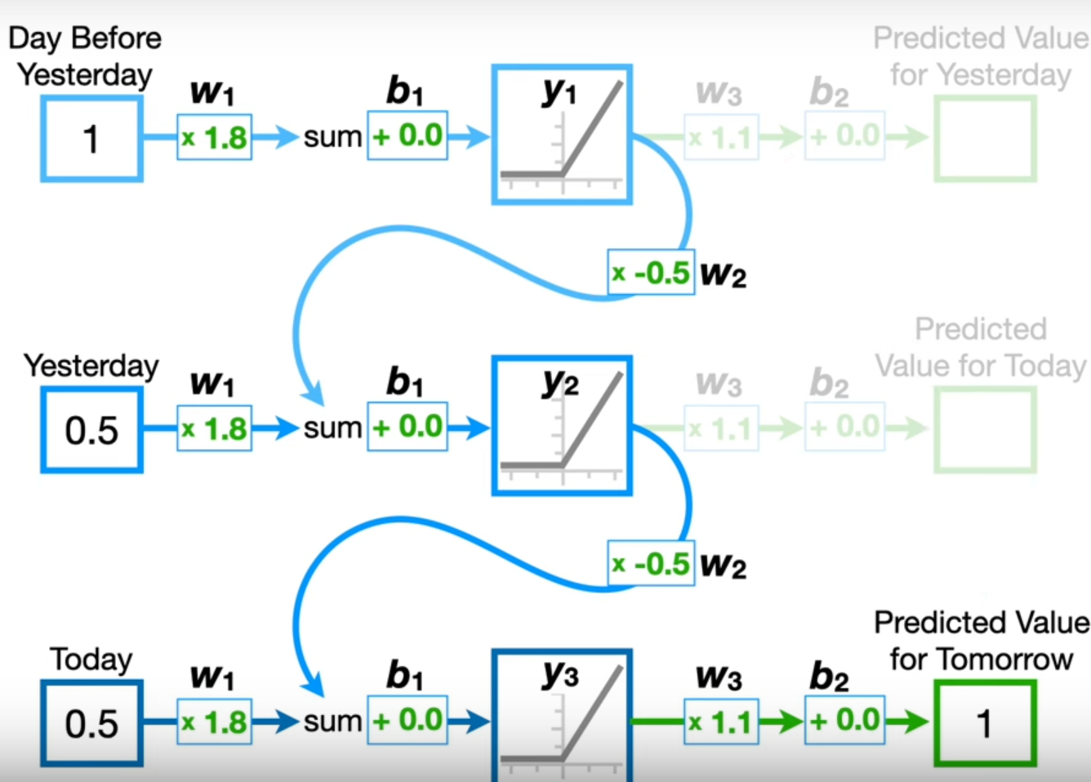
Recurrent Neural Network - Example
H0 = Relu (1 * 1.8 + 0) = 1.8
H1 = Relu (0.5 * 1.8 + 1.8 * -0.5 + 0) = 0
H2 = Relu (0.5 * 1.8 + 0 * -0.5 + 0) * 1.1 = 1

Slide 12
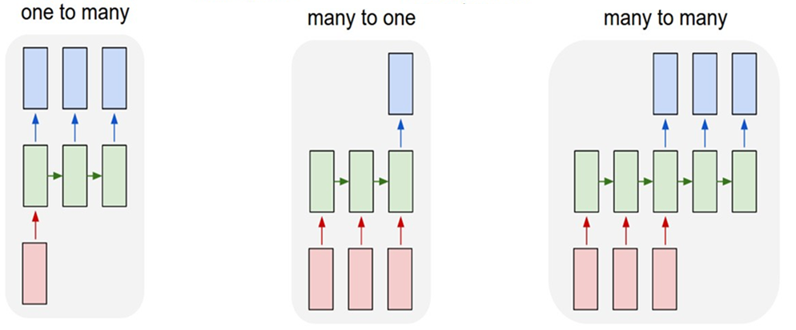
Recurrent Networks offer a lot of flexibility:
Text as a Sequence of Words
e.g. Image Captioning
image -> sequence of words
e.g. Stock Prediction
seq of stock prices -> future stock price
e.g. Machine Translation
seq of words -> seq of words

Slide 13
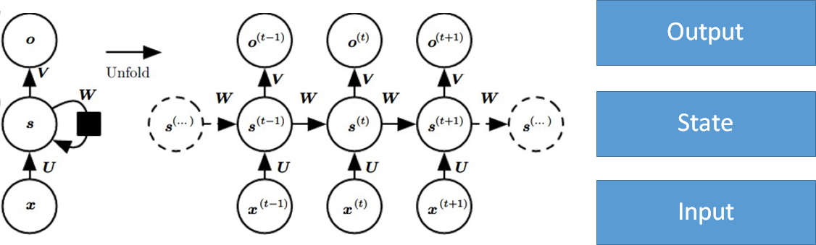
RNN for a Sequence of Words
-Feedforward network: a neural network without sequential dependencies (Not suitable for processing a sequence of data )
-RNNs store information about previous data of a sequence in the “state”
Hidden state: a summary of the previous data in a sequence
Each node receives the input entry and the hidden state of previous inputs to compute the output entry

Slide 14
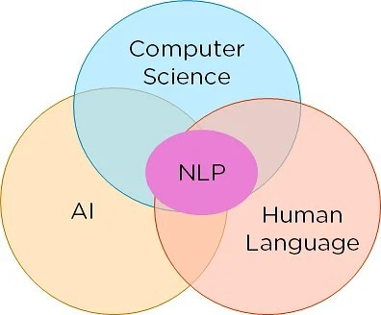
Natural Language Processing
Natural language processing (NLP) is the set of methods for making human language accessible to computers(Jacob Eisenstein)
NLP is the field at the intersection of Artificial intelligence and linguistics
The goal of NLP is to provide new computational capabilities around human language including extracting information from texts, translating between languages, answering questions, holding a conversation, etc.

Slide 15
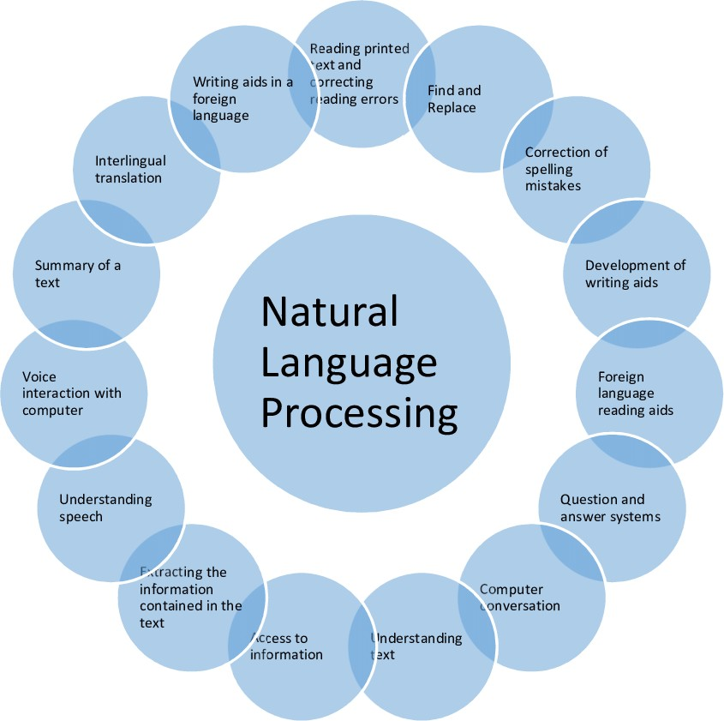
Applications of NLP
Question Answering
Text Summarization
Machine Translation
Chatbots / Dialog systems
Sentiment analysis
Information retrieval
Spelling & Grammar Check.
Autocorrect

Slide 16
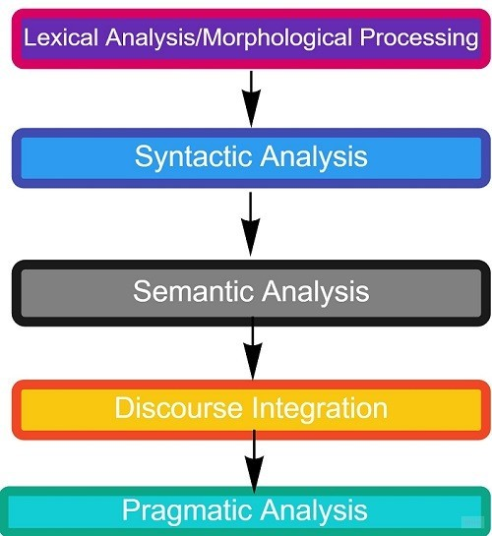
Phases of NLP
NLP can be broken down into five phases, each focusing on different aspects of language understanding and manipulation.
These phases make it possible that a machine can interpret and process language
These phases are required for NLP tasks and applications such as:
Machine Translation
Question Answering
Sentiment Analysis
…

Slide 17
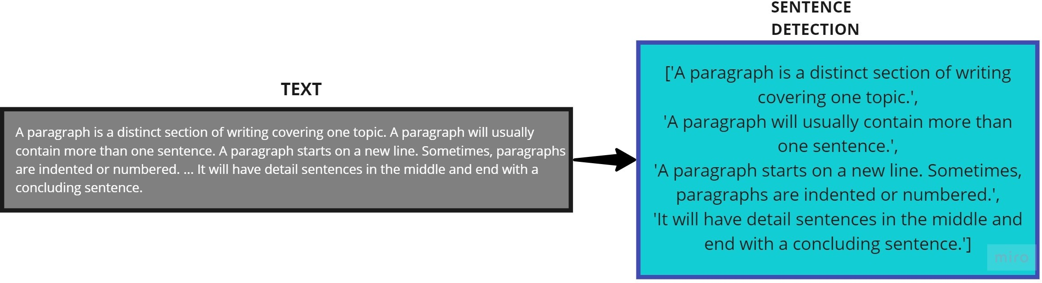
Lexical Analysis
Breaking down the input text into words, phrases, symbols, or other meaningful elements (called tokens).
These tokens are the smallest unit of text.
For example, The sentence “He goes to college.” is divided into [ ‘He’ , ‘goes’ , ‘to’ , ‘college’, ‘.’] .
A paragraph may also be divided into sentences.

Slide 18
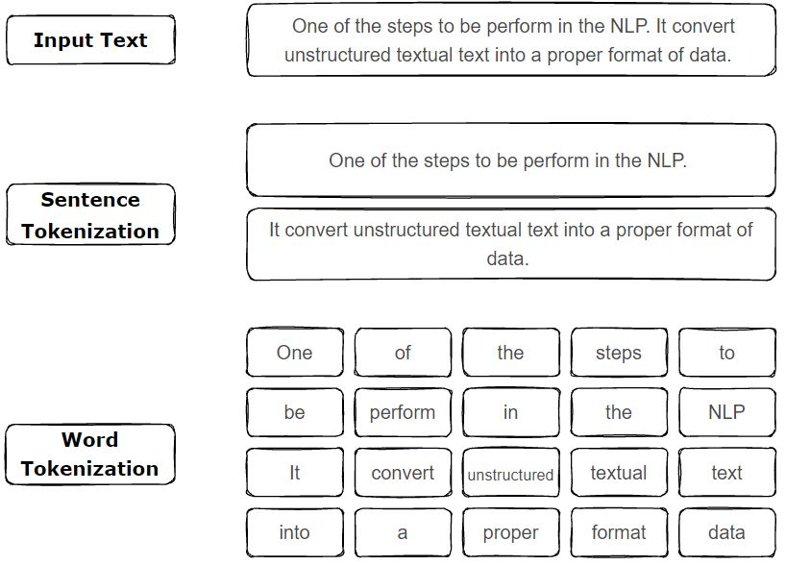
Word-based Tokenization
Each word in the text is considered a token
Splitting the text by spaces
Advantages:
Easy to implement
words are natural units in most languages
Disadvantages:
Languages without spaces between words (e.g., Chinese)
Misspelled words will be considered as a token
Huge vocabulary size

Slide 19
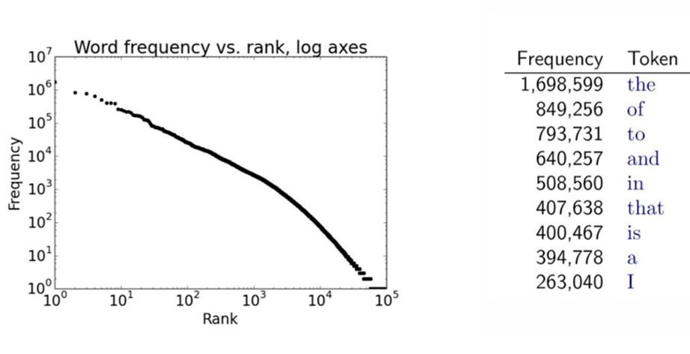
Challenges of NLP - Sparsity
Usually there are a lot of infrequent words in languages
Infrequent words make vocabulary large, and most words do not appear in any given document and training will be difficult.
Operations like distance calculations or matrix multiplications become slower when the matrices are large and sparse
One solution: Break down words into more frequent subword units
Infrequent Example: Antidisestablishmentarianism

Slide 20
Character-based Tokenization
Splitting the text into individual characters
Finest level of granularity
Advantages:
Usually small size of vocabulary (characters, special characters , etc.)
Since every character is a token, there will be no Out Of Vocabulary (OoV)
Easy to implement
Can handle languages without spaces
Disadvantages
Larger sequence to be processed by models require more computational resources.
Doesn't inherently capture word-level semantics
The model may struggle to understand the overall context
One solution:
Frequent meaningful subword units
"hello“ →
["h", "e", "l", "l", "o"]

Slide 21
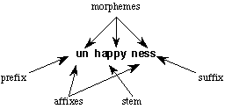
Morphological Processing
Focusing on identifying morphemes, the smallest units of a word that carry meaning and cannot be further divided.
Morphological analysis can help address sparsity by collapsing related words into a single representation
Types of Morphemes
Free Morphemes: Text elements that carry meaning independently and make sense on their own. For example, “happy” is a free morpheme.
Bound Morphemes: Elements that must be attached to free morphemes to convey meaning, as they cannot stand alone. For instance, the suffix “-ness” is a bound morpheme, needing to be attached to a free morpheme like “happy” to form “happiness.”
By distinguishing free morphemes from bound morphemes, we can reduce the size of vocabulary

Slide 22
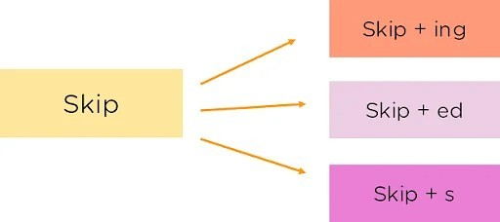
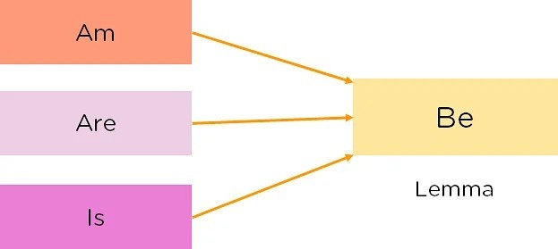
Stemming and Lemmatization
Reducing words to their base or root form:
Stemming is a process that extract stems by removing suffixes from a word
Lemmatization considers the context and converts the word to its meaningful base form, which is called Lemma
Stemming

Slide 23
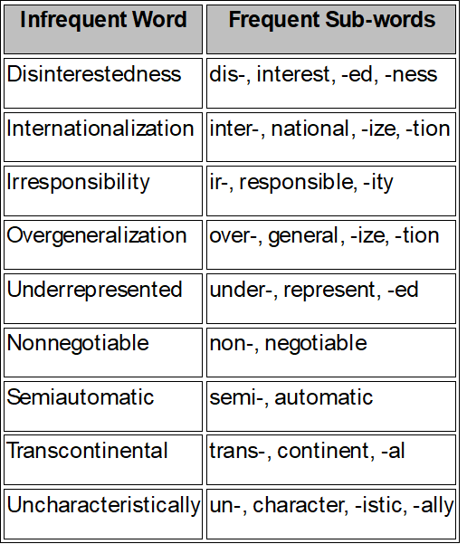
Subword Tokenization
Text is broken down into smaller units than words but larger than characters:
Frequently used words should not be split into smaller subwords
Rare words should be decomposed into meaningful subwords
Advantages
Capturing meaningful chunks of words while avoiding the excessive sequence lengths
Models can generalize across different forms of the same root word by breaking them down into common subwords
Out Of Vocabulary words can be handled
Manageable vocabulary sizes
Disadvantages
Requires more complex algorithms
Byte Per Encoding (BPE) and WordPiece are two examples of this scheme
Example: Antidisestablishmentarianism
-> Anti-, Dis-, Establish, -ment, -arian, -ism

Slide 24
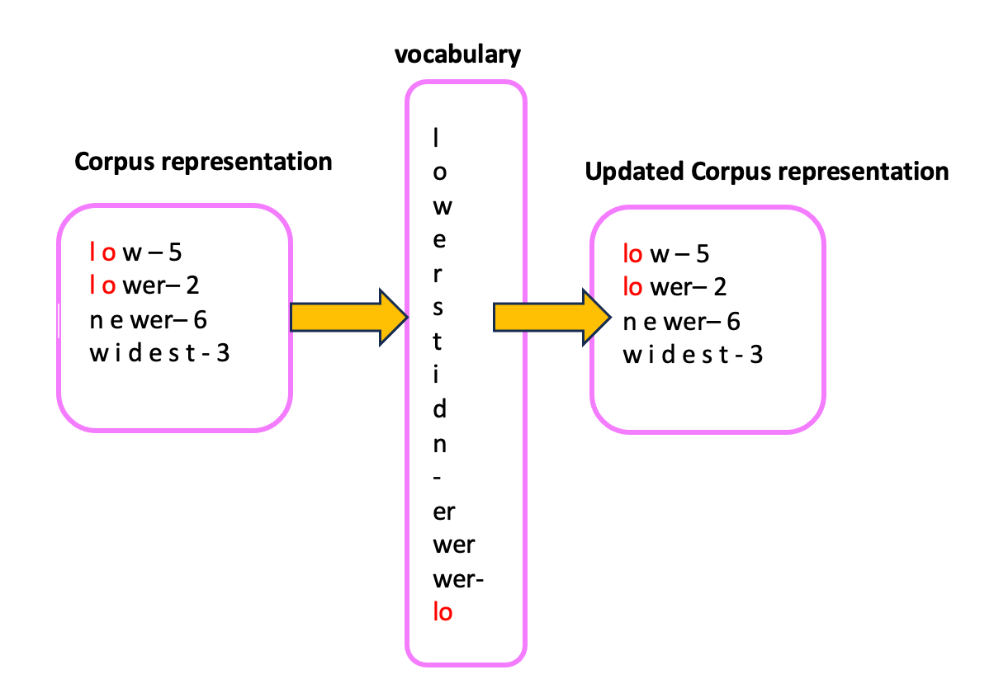
Byte-Pair Encoding (BPE)
Introduce new tokens by merging the most common adjacent pairs of tokens
Merge until a predefined number of merge operations or subwords is reached.
It helps create a fixed vocabulary size by representing words as a combination of their frequent subword components, thus improving the ability of the model to handle large vocabularies efficiently.
Handle rare or unknown words by breaking them down into smaller, more frequent subword units.

Slide 25
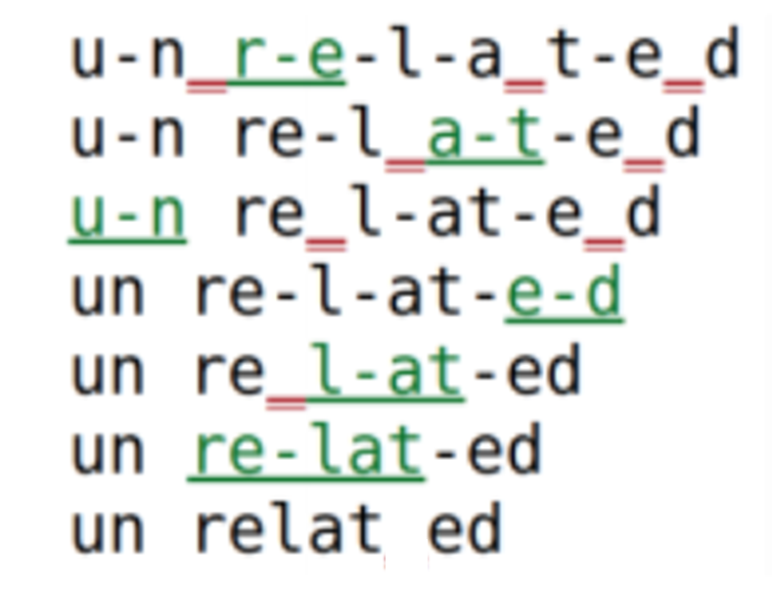
Byte-Pair Encoding (BPE) Steps
Starts with splitting the input words into single characters (each of them corresponds to a symbol in the final vocabulary)
Find the most frequent occurring pair of symbols from the current vocabulary
Merge and add this to the vocabulary and size of vocabulary increases by one
Repeat steps (2) and (3) till the defined number of tokens are built or no new combination of symbols exist with required frequency
In BPE inference, larger tokens are generally preferred for representing words

Slide 26
BPE Training- Example
Training data contains ["low", "lower", "lowest“] , min-frequency = 3:
1- Initial representation (characters):
low = ['l', 'o', 'w']
lower = ['l', 'o', 'w', 'e', 'r']
lowest = ['l', 'o', 'w', 'e', 's', ‘t’] (7 tokens in vocabulary)
2,3- Find and merge the most frequent character pairs in the corpus:
"l" and "o" are the most frequent pair:
low = ['lo', 'w']
lower = ['lo', 'w', 'e', 'r']
lowest = ['lo', 'w', 'e', 's', ‘t’] (8 tokens in vocabulary)
“lo" and “w" are the most frequent pair:
low = ['low']
lower = ['low', 'e', 'r']
lowest = ['low', 'e', 's', ‘t’] (9 tokens in vocabulary)
Repeat till maximum number of tokens or there is no frequent pair (based on minimum frequency threshold)

Slide 27
Advantages and Limitations of BPE
Efficient Vocabulary Size:
BPE limits the vocabulary size while still being able to represent a vast number of words by breaking rare words into subword units.
Handling Out-of-Vocabulary (OOV) Words:
BPE can break down unseen or rare words into smaller known subwords, helping the model generalize better.
Flexibility:
BPE ensures that common words are treated as whole units, while rare or complex words are split into meaningful subwords.
Suboptimal for Morphologically Rich Languages:
BPE can sometimes produce unnatural subword splits in languages with complex morphology.

Slide 28
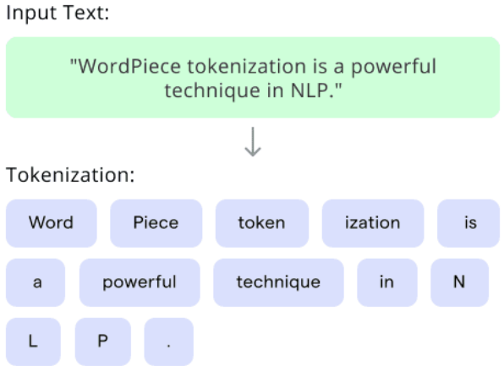
WordPiece Tokenization
WordPiece is a subword tokenization technique which merges characters and subwords in a way that preserves semantic meaning
WordPiece algorithm is similar to BPE
WordPiece chooses subword merges that maximizing the likelihood of sequence in the training data.
WordPiece tends to result in subword tokens that are more meaningful in languages with complex morphology

Slide 29
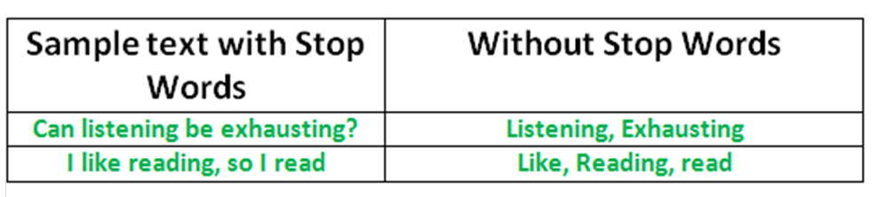
Normalization
Lowercasing, removing punctuation and stop-words and handling special characters.
Stopwords Removal: Eliminating Words that are function words helping form sentence structure: the, of, and, … :
Reduces the complexity of the text, helping focus on the more meaningful parts of the content
create a more uniform text
Can sometimes cause issues for NLP tasks: e.g., phrases: “to be or not to be”, “let it be”
For an application, an additional domain specific stop words list may be constructed

Slide 30
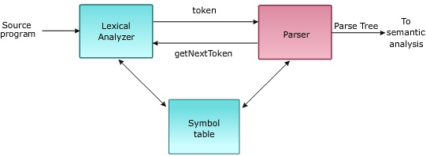
Syntactic Analysis
Structural relationships between words
The word arrangement is studied and a syntactic relationship is found between them.
Syntactic parser checks for word arrangements and grammar.
For example, the sentence “My is to him” is rejected by the syntactic parser.
Correct Syntax: “John eats an apple.”
Incorrect Syntax: “Apple eats John an.”
Correct Syntax: “ colorless green idea”

Slide 31
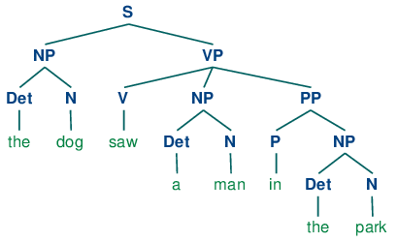
Syntactic Analysis
Phrase Structure Parsing (Traditional Approach):
Part-of-Speech (POS) Tagging: Assigning parts of speech (noun, verb, etc.) to each token.
Parsing: Determining the grammatical structure of the sentence by building a parse tree.
POS Tags example:
saw: Verb (V)
the: Determiner (Det)
dog: Noun (N)
Deep Learning-Based Methods:
Use deep neural networks to capture syntactic dependencies without explicit grammar rules.

Slide 32
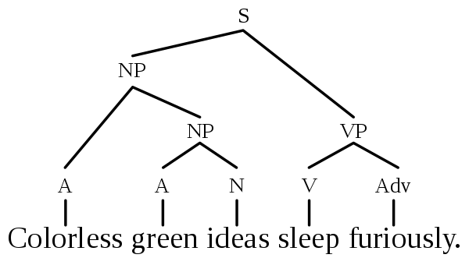
Semantic Analysis
Derive the meaning of the sentence (words together).
Unlike syntactic analysis, which deals with grammatical structure, semantic analysis is concerned with the literal and contextual meaning of words, phrases, and sentences.
e.g., “colorless green idea.” This would be rejected by the Symantec analysis as colorless Here; green doesn’t make any sense.
Correct Syntax: “ colorless green idea”
Incorrect Semantic: “ colorless green idea”

Slide 33
Challenges of NLP - Ambiguity
Lexical Ambiguity: Different meaning of a word in different context
Example: The word “bat” can refer to a flying mammal or a piece of sports equipment.
Referential Ambiguity: A word or phrase could refer to multiple entities
Example: In the sentence, "Apple announced its new product line," the word Apple could refer to the fruit or the tech company
NFR and WSD can be used to address these issues

Slide 34
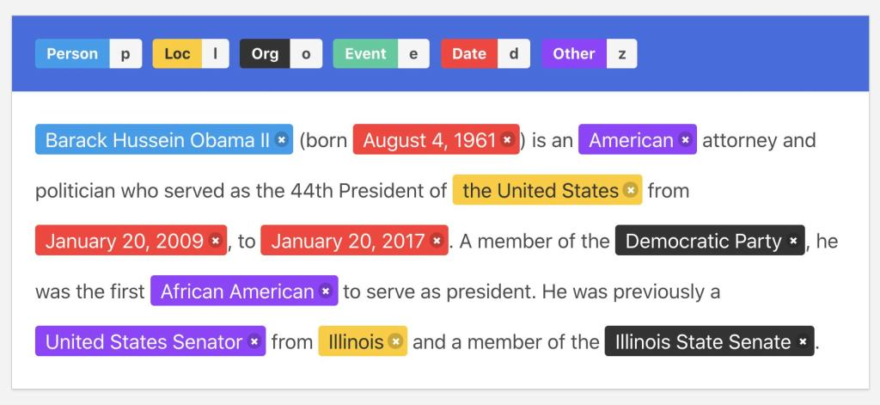
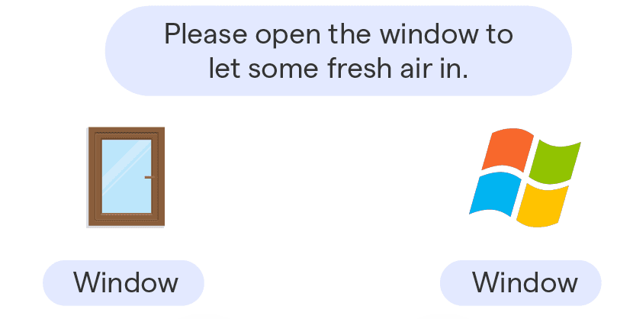
Key Tasks in Semantic Analysis
Named Entity Recognition (NER): NER identifies and classifies entities within the text, such as names of people, places, and organizations.
Word Sense Disambiguation (WSD): WSD determines the correct meaning of ambiguous words based on context.

Slide 35
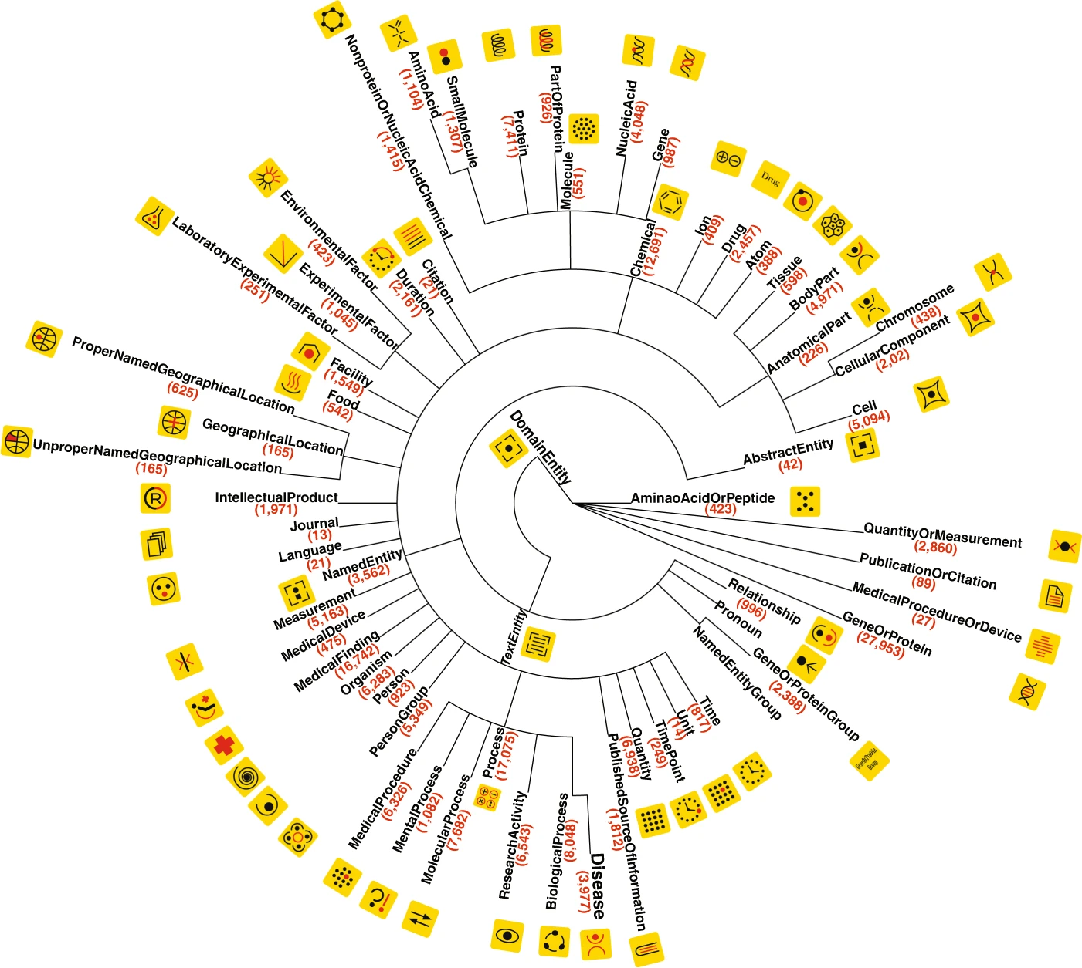
Methods of Semantic Analysis
Traditional Approaches:
Conventional ML Approaches:
Classifiers such as decision trees are used to classify a word’s sense based on contextual features (e.g., surrounding words)
Ontology-Based Methods:
These methods rely on ontologies and semantic networks
Deep Learning-Based Methods
Deep neural networks are used to automatically learn meaning of words from raw text based on context

Slide 36
Discourse Integration
Understand how individual sentences are connected to form a coherent message.
Co-reference Resolution: Identifying when different words refer to the same entity.
Pronoun Resolution: Finding the noun that a pronoun refers to.
Example: "John likes pizza. He eats it often." Resolving "He" to "John" and "it" to "pizza."

Slide 37

Discourse Integration - Some Methods
Traditional Approaches:
Rule-Based Approaches:
Use linguistic, syntactic and semantic rules (e.g., pronouns often refer to the most recently mentioned noun).
Discourse Parsing:
identify the structure of discourse by determining relationships between sentences or clauses, such as elaboration, contrast, and causality.
Deep Learning-Based Methods:
Deep neural networks are used to learn dependencies from raw text using attention mechanism

Slide 38

Pragmatic Analysis
Interpret the text considering the context and implied meanings.
Understanding implied meanings, user intent, and tone.
Handling idiomatic expressions and conversational maxims.
Example: "Can you open the door?" is interpreted as a request, not a question about ability.
Expressivity as a challenge of NLP: the same meaning can be expressed with different forms

Slide 39

Pragmatic Analysis - Some Methods
Traditional Approaches:
Knowledge Graphs:
Use structured knowledge (e.g., domain-specific information) to interpret text within the context of a specific field or situation.
Rule-Based Models:
Detect common linguistic markers and patterns..
Deep Learning-Based Methods:
Deep neural networks are trained on huge data to learn the intent of text based on different contexts

Slide 40

NLP Tasks - Language Generation
Generate human-like text based on certain inputs
It involves the use of language models to generate coherent and contextually appropriate text
Example: Given the prompt, "Write a story about a cat," the system generates a narrative.
Input can be a text from different language (in translation)
A Question (in question answering)
Etc.

Slide 41

Language Model
Independently choosing the most likely word doesn’t guarantee that the individual choices make sense together
A language model can predict the likelihood of a sequence of words
E.g., Probability of different combination of following words:
I fed my cat with meat: P(I, fed, my, cat, with, meat) = 0.3
My cat fed I with meat: P(My, cat, fed, I, with, meat) = 0.005

Slide 42

Autoregressive Language Models
A class of models in NLP that generate text by predicting the next token in a sequence, based on the previously generated tokens
The chain rule of conditional probability:
P(I, fed, my, cat, with, meat) = P(I)
P(fed | I)
P(my | I, fed)
P(cat | I, fed, my)
P(with | I, fed, my, cat)
P(meat | I, fed, my, cat, with)

Slide 43


Autoregressive Models
We can use an RNN to generate text
At each step, predicts the next token in a sequence using previous steps.
This is a classification using softmax on a vocabulary
Hidden state conveys the context of all previous words

Slide 44

Example
P(my | I, fed)
P(cat | I, fed, my)
P(fed | I)
Suppose that our vocabulary just has 4 words :
[I, my, cat, fed]
The model is trained on different text as training data to learn what is the probability of each of these words after a sequence of others
Classes:
my
I
cat
fed

Slide 45



Sentence Completion using an RNN
Trained Neural Language model can be used to complete a given sequence of words.
The last hidden state of prefix encoded the context of information of all previous states and the last prediction of prefix contains the most likely next word.
$Most probable word=softmax$(V$h_{t}$)
$h_{t}=$g($h_{t−1}$+W${∗x}_{t}$)

Slide 46

NLP Tasks - Translation
A text in source language, enters into the network to generate context (hidden states)
Autoregressive, generates a word in the context of the hidden state in target language
Subsequent words are conditioned on the previous hidden state and the last word generated

Slide 47


Encoder and Decoder
NLP tasks can be generally decomposed into language understanding and language generation:
Encoder models are generally used to understand input sentences, and decoder models are generally used to generate sentences.
An encoder that accepts an input sequence and generates a context vector, conveys the essence of the input to the decoder.
A decoder, which accepts context as input and generates an arbitrary length sequence of outputs

Slide 48


Encoder‐Decoder Networks Decoder
One weakness of this approach is that the influence of the context vector, will wane as the output sequence is generated (only short term memory but not long term memory).
A solution is to make the context vector available at each step in the decoding process by adding it as a parameter to the computation of the current hidden state.

Slide 49

Long Term vs Short Term
Long term memory is needed to represent the context of the source text
Short term memory is needed to represent of previous words in target language
trained on sentences in first language
trained on sentences in second language
Hidden state in decoder (short memory)
context (long memory)

Slide 50


Encoder Decoder Networks
Encoder: takes an input sequence and generates a contextualized representation of the inputs.
Context vector: conveys the essence of the input to the decoder.
Decoder: takes the context vector and autoregressively (predict future values based on past ones) generates a sequence of outputs with arbitrary length

Slide 51

Encoder Decoder - Conversation Example
Encoder: Trained on the language sentences to takes an input sentence (sequence of words) in the language and generates a contextualized representation of the sentence.
Decoder: Trained on the responses and autoregressively create statements based on the input context

Slide 52

Encoder‐Decoder Training
Encoder‐decoder architectures are trained end‐to‐end
Each training example is a tuple of paired strings, a source and a target.
E.g., for machine translation, the training data typically consists of sets of sentences and their translations.

Slide 53

Teacher Forcing
Teacher forcing involves feeding observed sequence values (i.e. ground-truth samples) back into the RNN after each step, thus forcing the RNN to stay close to the true sequence.
During training, the model is given the actual target (correct) sequence as input at each step instead of its previously generated tokens in teacher forcing.

Slide 54

Exploding and Vanishing Gradient Problem
In backpropagation, the recurrence multiplication of gradients can result in difficulties called exploding and vanishing gradient problem
In vanishing gradients, the gradient of a long-term interaction has exponentially smaller magnitude than the gradient of a short-term interaction therefore, it might take a very long time to learn long-term dependencies
Output = Relu(Relu(Relu(x1*w1) * W2 + x2*W1)* W2 + x3*w1)
W1 = w1 - Learning Rate * $\frac{∂E}{∂w_{1}}$
Rule Chain: $\frac{∂E}{∂w_{1}}$ = $\frac{∂E}{∂output}$ * $…$
$→$ $\frac{∂E}{∂W_{1}} includes$ many multiplications of $W_{2}$ (e.g., ${W_{2}}^{50}$)
If $W_{2}$ is between 0 and 1 then $\frac{∂E}{∂W_{1}}$ would be very small (vanishing)
If $W_{2}$ is bigger than 1 then $\frac{∂E}{∂W_{1}}$ would be very large (exploding)
Error (E)
Real Output

Slide 55


Long Short-term Memory (LSTM)
Capable of modeling longer term dependencies by having memory cells and gates that controls the information flow along with the memory cells
Just like a simple RNN, an LSTM also has a hidden state of the previous timestamp, known as short term memory.
The cell state is known as long term memory carries the information along with all the timestamps.

Slide 56

Encoder‐Decoder Bottle-Neck
This context vector is the hidden state of the last time step of the source text.
This final hidden state is thus acting as a bottleneck:
It must represent absolutely everything about the meaning of the source text
Information at the beginning of the sentence, especially for long sentences, may not be equally well represented in the context vector.

Slide 57

Attention
The idea of attention is instead to use one static context, taking a weighted sum of all the encoder hidden states.
The weights focus on (‘attend to’) a particular part of the source text that is relevant for the token the decoder is currently producing.
This context vector, is generated anew with each decoding step
The context value 𝑐_{i} is one of the inputs to the computation of ℎ^{d}. It is computed by taking the weighted sum of all the encoder hidden states, each weighted by their dot product with the prior decoder hidden state ℎ^{d} .

Slide 58

Attention - Example
Most relevant world in source text are attending in the context of target words
Example: machine translation

Slide 59


Attention - Example
Translating an English sentence into French:
“The quick brown fox jumps over the lazy dog”
To translate the word "renard" (French for "fox"):
Input Word | Attention Weight
The | 0.10
quick | 0.10
brown | 0.25
fox | 0.45
jumps | 0.01
over | 0.01
lazy | 0.01
dog | 0.01

Slide 60
Attention
Long-Range Dependencies:
Instead of relying on a single final hidden state from the encoder, attention allows the decoder to dynamically focus on relevant parts of the input sequence, regardless of how far back they are.
.
Bottleneck Problem:
In standard RNNs, all the information from the input sequence is compressed into a single hidden state, which can lead to information loss for long sequences. Attention avoids this by considering all hidden states during decoding.

Slide 61
Assignment
Train BPE tokenizer on train.txt file using following hyper-parameters:
min_frequency=2, vocab_size=20
min_frequency=2, vocab_size=50
min_frequency=3, vocab_size=50
Use each of trained model to encode the following sentence:
“he is unfair and unaware and unresponsive”
Which set of hyper-parameters creates best results?
is he fair and aware and responsive ?
he is fair and aware and responsive
he is unhappy and unkind and unpleasant

